Slide 1
PROMOTING EXCELLENCE IN CLINICAL RESEARCH
© Association of Clinical Research Professionals ǀ acrpnet.org

Slide 2
ACRP OVERIVEW
WHO IS ACRP?
© Association of Clinical Research Professionals ǀ acrpnet.org

Slide 3
ACRP OVERVIEW
NON-PROFIT & MISSION-FOCUSED
Registered 501(c)(3) Organization
Founded in 1976
Based in Washington, DC (Alexandria, Virginia Office)
13,000+ Individual Members in 70+ Countries
Vision: Clinical Research is Performed Ethically, Responsibly, Professionally Everywhere in the World
© Association of Clinical Research Professionals ǀ acrpnet.org

Slide 4
MISSION: To Promote Excellence in Clinical Research
© Association of Clinical Research Professionals ǀ acrpnet.org

Slide 5
ACRP OVERVIEW
LEADING WORKFORCE DEVELOPMENT
ACRP is focused on the people at the heart of clinical trials. While suppliers and leading organizations like TransCelerate BioPharma and the Clinical Trials Transformation Initiative focus efforts on improving clinical trial quality and efficiency through innovation in process and technology, ACRP is leading development of the grassroots professionals conducting clinical trials.
© Association of Clinical Research Professionals ǀ acrpnet.org

Slide 6
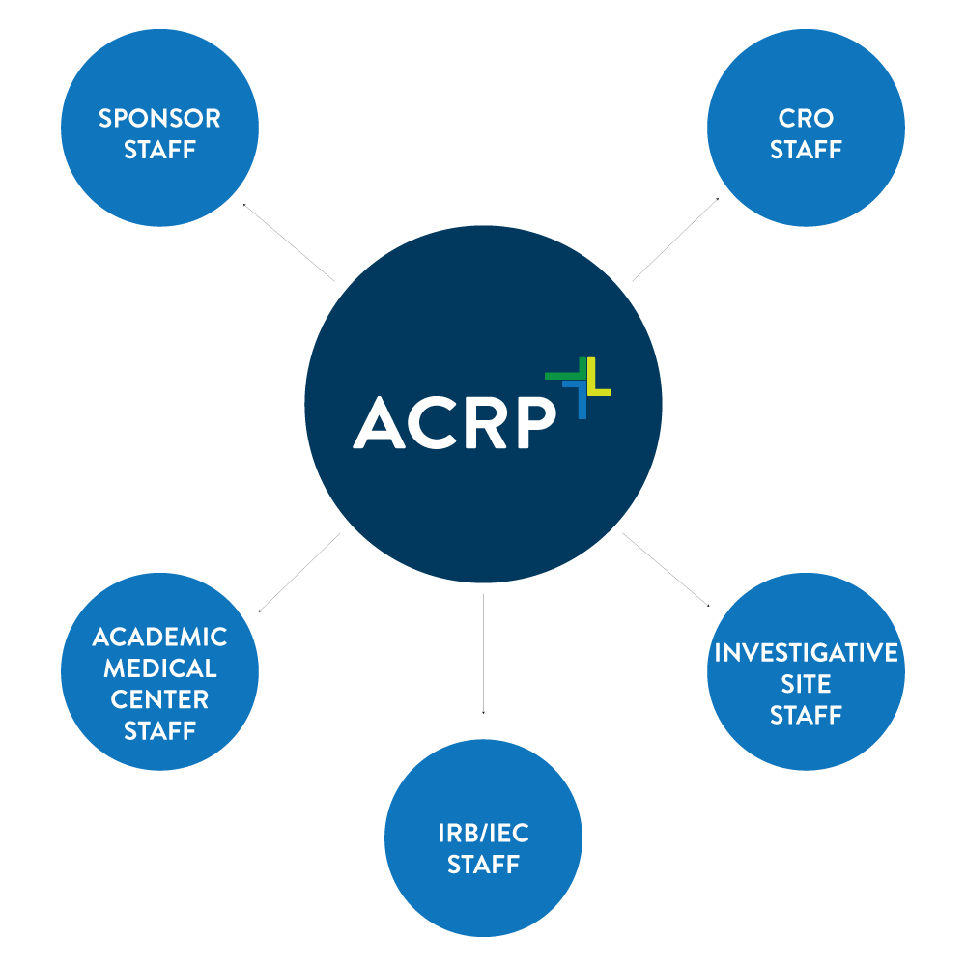
ACRP OVERVIEW
SETTING STANDARDS & SUPPORTING QUALITY
ACRP is setting standards for clinical research competence and workforce development. ACRP supports professionals and organizations of all kinds with the training and certification programs necessary for clinical trial quality and efficiency improvements. ACRP supports implementation of process and technology advancements as they evolve.
© Association of Clinical Research Professionals ǀ acrpnet.org

Slide 7
ACRP OVERVIEW
MISSION-DRIVEN PROGRAMS
ACRP is developing competence and supporting its mission through core programs of Membership, Training and Development, and Certification.
© Association of Clinical Research Professionals ǀ acrpnet.org

Slide 8
MISSION-DRIVEN PROGRAMS
MEMBERSHIP
© Association of Clinical Research Professionals ǀ acrpnet.org

Slide 9
MEMBERSHIP
13,000+ GLOBAL MEMBERS
© Association of Clinical Research Professionals ǀ acrpnet.org

Slide 10
MEMBERSHIP
ACRP MEMBER BENEFITS
News and Information
ACRP Blog
Clinical Researcher
ACRP CR Beat
Community
Local Chapters
Interest Groups
Online Discussion Boards
Shared Resources
© Association of Clinical Research Professionals ǀ acrpnet.org

Slide 11
MEMBERSHIP
ACRP MEMBER BENEFITS
Resources
GCPartner App (Free Download)
ACRP Career Center
Virtual Career Fairs
White Papers
Training & Development Benefits
Discounted Training Programs
Discounted Certification Fees
Access to Home Study Testing
© Association of Clinical Research Professionals ǀ acrpnet.org

Slide 12
MEMBERSHIP
STAY IN TOUCH
Facebook: facebook.com/acrpdc
Twitter: twitter.com/acrpdc
LinkedIn: linkedin.com/company/association-of-clinical-research-professionals
© Association of Clinical Research Professionals ǀ acrpnet.org

Slide 13
Learn More
acrpnet.org/membership
© Association of Clinical Research Professionals ǀ acrpnet.org

Slide 14
MISSION-DRIVEN PROGRAMS
TRAINING & DEVELOPMENT
© Association of Clinical Research Professionals ǀ acrpnet.org

Slide 15
TRAINING & DEVELOPMENT
HARMONIZED CORE COMPETENCE ALIGNMENT
ACRP Training and Development Programs Aligned with Harmonized Core Competency Framework for Clinical Research Professionals
Framework Developed by the Joint Task Force on Clinical Trial Competence:
ACRP, Pfizer, Multi-Regional Clinical Trial Center at Harvard, Clinical Trials Transformation Initiative, Alliance for Clinical Research Excellence and Safety, Consortium of Academic Programs in Clinical Research, More
Framework Defines 8 Core Competence Domains for All Clinical Research Professionals
© Association of Clinical Research Professionals ǀ acrpnet.org

Slide 16
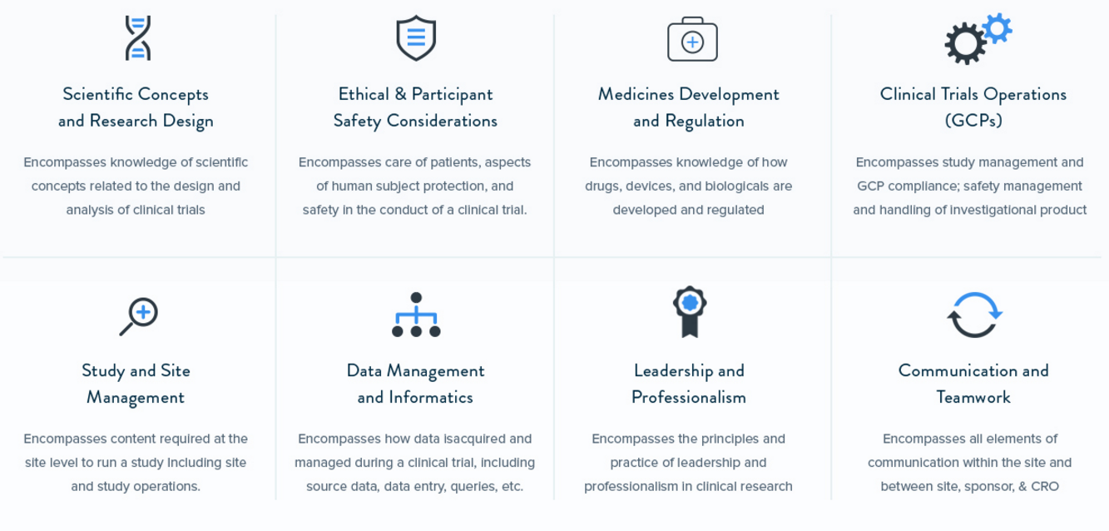
TRAINING & DEVELOPMENT
CORE COMPETENCE DOMAINS
© Association of Clinical Research Professionals ǀ acrpnet.org

Slide 17
TRAINING & DEVELOPMENT
ONLINE & CLASSROOM TRAINING PROGRAMS
Designed to Build Professional Competence
Accredited to Provide CBRN (Nursing) and ACCME (Physician) Continuing Education Units
Developed to Meet Adult Learning Needs
Immersive and Interactive to Aid Content Retention
© Association of Clinical Research Professionals ǀ acrpnet.org

Slide 18
TRAINING & DEVELOPMENT
CAREER LIFECYCLE DEVELOPMENT
Foundational Programs
Introduction to Clinical Research
Fundamentals of Clinical Research
Ethics & Human Subject Protection
Introduction to Good Clinical Practice
ICH Guidelines E2A, E6, E8, E9
© Association of Clinical Research Professionals ǀ acrpnet.org

Slide 19
TRAINING & DEVELOPMENT
CAREER LIFECYCLE DEVELOPMENT
Intermediate- and Advanced-Level Programs
Project Management
GCP for Experienced Professionals
Specialized Topics, Such As:
Quality Management
Risk-Based Monitoring
Root Cause & CAPA
Trial Protocols
Budgeting & Billing Compliance
Inspection Readiness
eResearch
© Association of Clinical Research Professionals ǀ acrpnet.org

Slide 20
TRAINING & DEVELOPMENT
LIVE & ON-DEMAND WEBINARS
1-Hour Online Sessions Covering
Regulatory Developments
Trends Impact Clinical Trials
Specialized Topics
© Association of Clinical Research Professionals ǀ acrpnet.org

Slide 21
TRAINING & DEVELOPMENT
HOME STUDY
Learn and Earn Contact Hours through Clinical Researcher Articles
Each Test Based on 3 Articles in Issue of Clinical Researcher
Open-Book Test Provides 3 Continuing Education Units for Maintenance of Certification or License Renewal Efforts
© Association of Clinical Research Professionals ǀ acrpnet.org

Slide 22
TRAINING & DEVELOPMENT
ACRP MEETING & EXPO
Annual ACRP Conference Offering
3.5 Days of Immersive Learning & Networking
100+ Educational Sessions
Continuing Education Units
Thought-Leader Keynote Sessions
Networking Opportunities
In-Depth Pre-Conference Workshops
On-Demand, Recorded Content Available Post Conference
© Association of Clinical Research Professionals ǀ acrpnet.org

Slide 23
Learn More
acrpnet.org/training
© Association of Clinical Research Professionals ǀ acrpnet.org

Slide 24
MISSION-DRIVEN PROGRAMS
CERTIFICATION
© Association of Clinical Research Professionals ǀ acrpnet.org

Slide 25
CERTIFICATION
30,000+ ACRP CERTIFIED PROFESSIONALS
© Association of Clinical Research Professionals ǀ acrpnet.org

Slide 26
CERTIFICATION
INDEPENDENT, ACCREDITED, RECOGNIZED
Independently Administered by the Academy of Clinical Research Professionals
Accredited by the National Commission for Certifying Agencies (NCCA) as Meeting Highest Standards for Development, Administration, and Governance of Certification and Testing Programs
Recognized by TransCelerate BioPharma as Evidence of GCP Training
Recognized by American Nurses Credential Center (ANCC) as Assisting Achievement of Magnet Recognition
© Association of Clinical Research Professionals ǀ acrpnet.org

Slide 27
CERTIFICATION
INDIVIDUAL BENEFITS OF ACRP CERTIFICATION
Validating Your Understanding of International Clinical Research Standards and Ability to Apply Knowledge on the Job
Committing to Quality Standards
Promoting Professionalism
Setting Yourself Apart
© Association of Clinical Research Professionals ǀ acrpnet.org

Slide 28
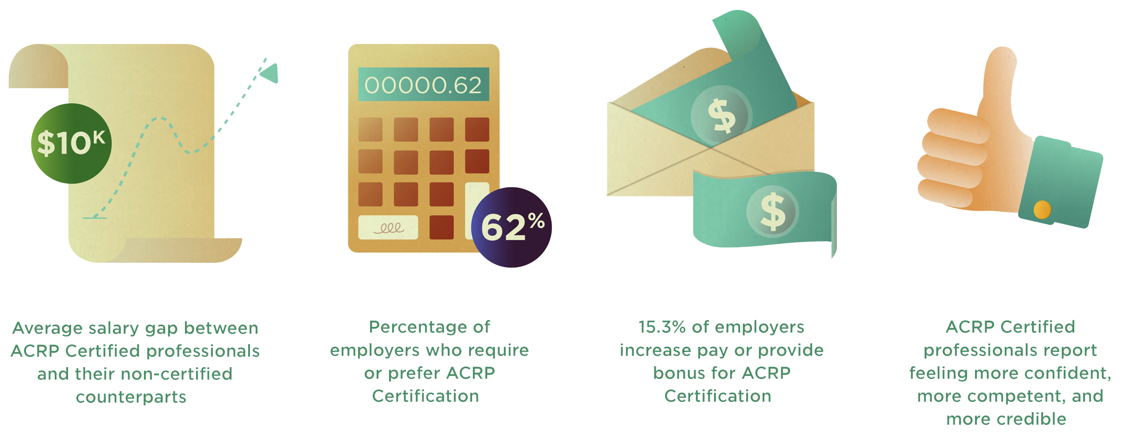
CERTIFICATION
INDIVIDUAL BENEFITS OF ACRP CERTIFICATION
© Association of Clinical Research Professionals ǀ acrpnet.org

Slide 29
CERTIFICATION
EMPLOYER BENEFITS OF ACRP CERTIFICATION
Validating Your Staff’s Understanding of International Clinical Research Standards and Ability to Apply Knowledge on the Job
Committing to Quality Standards
Promoting Professionalism
Setting Yourself Apart
Improved Business Outcomes
© Association of Clinical Research Professionals ǀ acrpnet.org

Slide 30
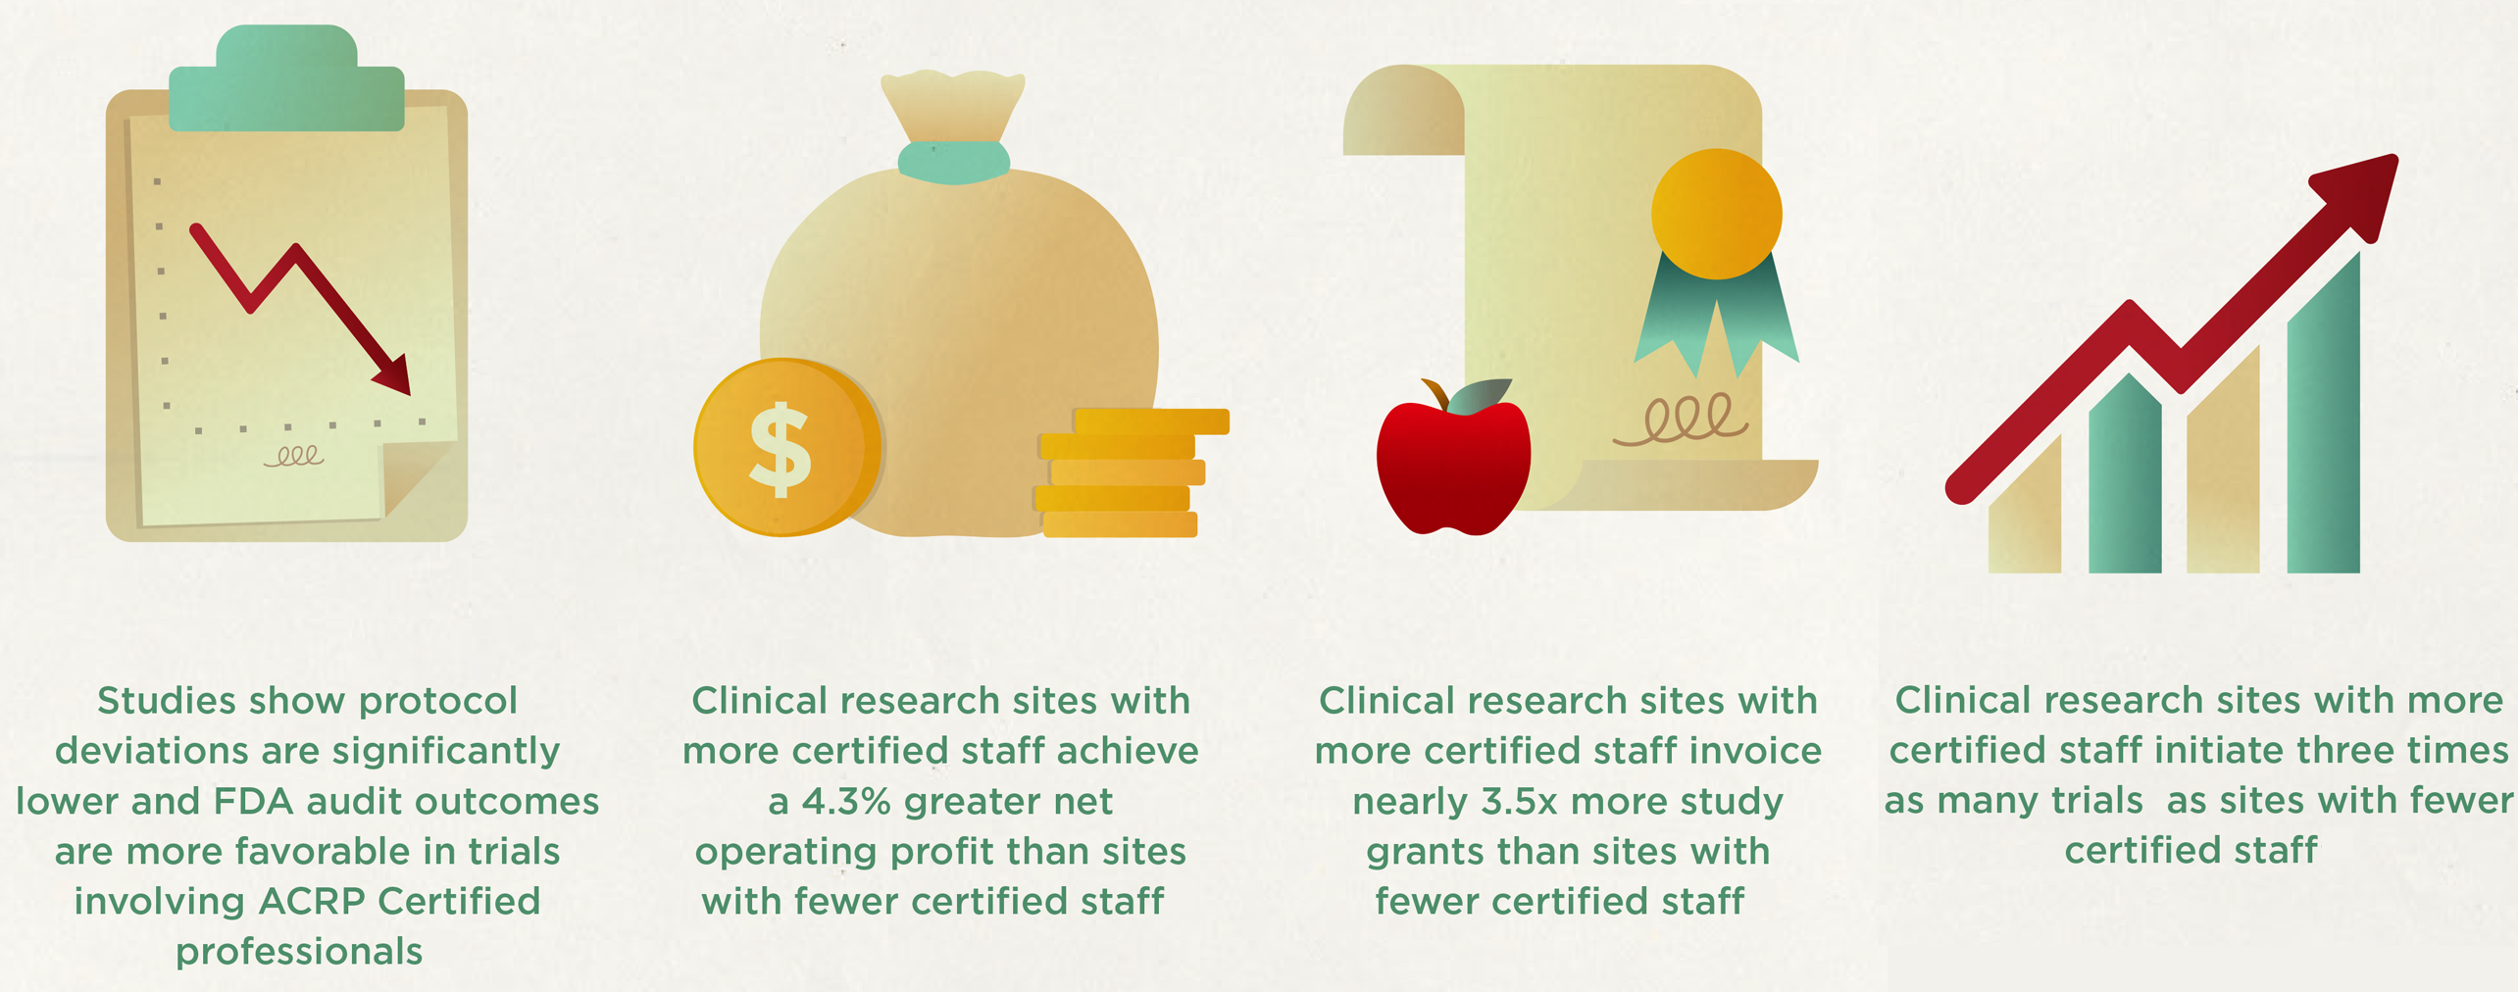
CERTIFICATION
EMPLOYER BENEFITS OF ACRP CERTIFICATION
© Association of Clinical Research Professionals ǀ acrpnet.org

Slide 31
CERTIFICATION
EXAM DETAILS
Exams Held in Fall and Spring at 600+ Locations in 80+ Countries
$435 Fee Required Upon Submission (Early-Bird Pricing)
Applicants Must Meet Exam Eligibility Requirements, Including Minimum of 2 Years’ Experience in Role of CRA, CRC, or PI
Certification Valid for 2 Years and Requires Bi-Annual Maintenance
Exams Grounded in ICH Guidelines, Including Good Clinical Practice
Testing Unique Knowledge and Skills Required of CRAs, CRCs, PIs
Consists of 125 Multiple-Choice Items
© Association of Clinical Research Professionals ǀ acrpnet.org

Slide 32
CERTIFICATION
MAINTENANCE DETAILS
Does NOT Require Re-Taking Exam
Maintenance of Certification Required Every Two Years
$215 Fee Required Upon Application Submission (Early-Bird Pricing)
Applicants Must Earn and Report 24 Points
Points May be Earned through Continuing Involvement and/or Continuing Education
© Association of Clinical Research Professionals ǀ acrpnet.org

Slide 33
CERTIFICATION
EXAM PREPARATION
Become Intimately Familiar with ICH Guidelines E6, E2A, E8, and E9
Leverage Optional Certification Exam Prep Support, Including:
Exam Practice Exercise
Exam Prep eLearning Course
ICH Gap Analysis Tool
ICH Flashcard Challenge
Prep Packages
© Association of Clinical Research Professionals ǀ acrpnet.org

Slide 34
Learn More
acrpnet.org/certification
© Association of Clinical Research Professionals ǀ acrpnet.org

Slide 35
MISSION-DRIVEN PROGRAMS
BUSINESS SOLUTIONS
© Association of Clinical Research Professionals ǀ acrpnet.org

Slide 36
BUSINESS SOLUTIONS
CORE PROGRAMS SUPPORTING ORGANIZATIONS
Talent Acquisition
Staff Development and Retention
Branding and Marketing
© Association of Clinical Research Professionals ǀ acrpnet.org

Slide 37
BUSINESS SOLUTIONS
TALENT ACQUISITION
Custom Recruitment Programs Leveraging ACRP’s Network of Qualified Professionals
ACRP Career Center Offering Single and Multiple Job Post Packages
Virtual Career Fairs Offering Live, Online Recruitment Opportunities
© Association of Clinical Research Professionals ǀ acrpnet.org

Slide 38
BUSINESS SOLUTIONS
STAFF DEVELOPMENT & RETENTION
eLearning License Programs Delivering Comprehensive Staff Training
20+ SCORM-Compliant Online Training Programs
Delivery via Sub-branded ACRP Learning Management System or Organization’s Internal LMS
Flexible Programs and Pricing to Meet All Organization Sizes and Budgets
© Association of Clinical Research Professionals ǀ acrpnet.org

Slide 39
BUSINESS SOLUTIONS
STAFF DEVELOPMENT & RETENTION
CRC Boot Camp Program
5-Day Live Training Delivering Competent Entry-Level CRCs
Intensive Program Covering: Informed Consent; IRB Submissions; Study Visits; Essential Documents; Safety Reporting; Monitoring Visits; Inspections
CRA Onboarding Program
Multi-Week Live & Online Training Delivering Competency Entry-Level CRAs
Intensive Training Program Covering: Introduction to Clinical Research; Ethics; GCP and ICH Guidelines; CRA Roles and Responsibilities; Business Management Skills; More
© Association of Clinical Research Professionals ǀ acrpnet.org

Slide 40
BUSINESS SOLUTIONS
STAFF DEVELOPMENT & RETENTION
Classroom Training License Program
ACRP Delivers Content and Trainer, or
ACRP Delivers Content and Trains Your Trainers
5 Programs Covering: Fundamentals of Clinical Research; Project Management; Advanced GCP; Root Cause and CAPA; Risk-Based Decision Making
Custom Course Development and Delivery
© Association of Clinical Research Professionals ǀ acrpnet.org

Slide 41
BUSINESS SOLUTIONS
BRANDING & MARKETING
Print and Digital Advertising Campaigns
Social Media Campaigns
Email Campaigns
ACRP Meeting & Expo
© Association of Clinical Research Professionals ǀ acrpnet.org

Slide 42
Learn More
Talent Acquisition, Branding & Marketing
Staff Development & Retention
Tammy B. Workman, CEM
Advertising & Exhibit Sales Manager
+1.703.254.8112
tworkman@acrpnet.org
Jenna Rouse
Director, Business Development
+1.703.254.8109
jrouse@acrpnet.org
© Association of Clinical Research Professionals ǀ acrpnet.org

Slide 43
VOLUNTEER-DRIVEN
HOW TO GET INVOLVED
© Association of Clinical Research Professionals ǀ acrpnet.org

Slide 44
GETTING INVOLVED
VOLUNTEERING
ACRP Runs on Contributions of Volunteers
ACRP Board of Trustees
Academy Board of Trustees
Committees
Chapter Leadership
© Association of Clinical Research Professionals ǀ acrpnet.org

Slide 45
GETTING INVOLVED
OTHER WAYS TO CONTRIBUTE
Writing Articles for Clinical Researcher
Sharing Your Knowledge through Webinars
Presenting at ACRP Meeting & Expo
Leading an Interest Group
Contributing to the Online Community
© Association of Clinical Research Professionals ǀ acrpnet.org

Slide 46
Learn More
acrpnet.org/volunteer
© Association of Clinical Research Professionals ǀ acrpnet.org

Slide 47
THANK YOU
© Association of Clinical Research Professionals ǀ acrpnet.org

